Slide 1
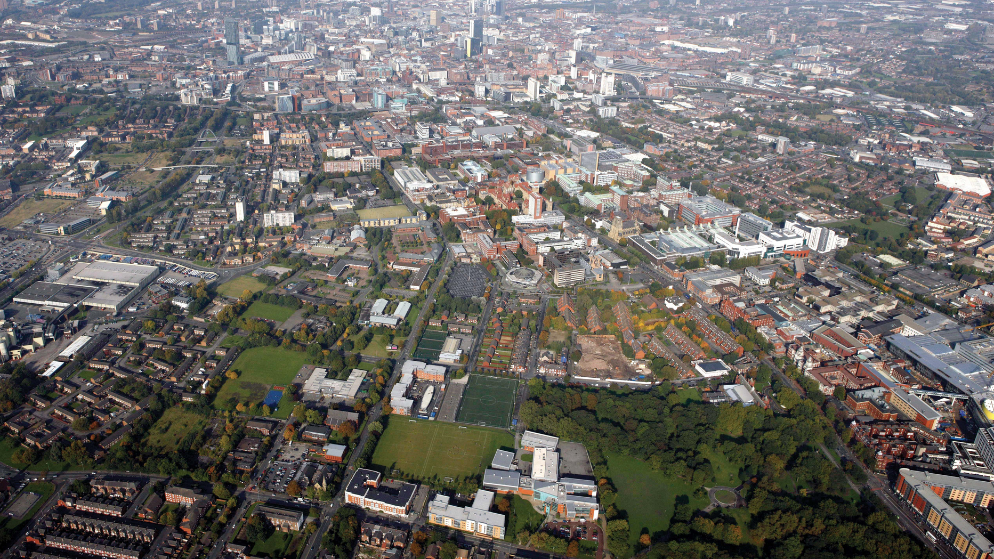
Manchester Restaurant Proposal Coursera Capstone Project Innes McLaren Feb 2021

Slide 2
Background
Our client is a Venture Capitalist who wants to invest in the catering industry in the United Kingdom (UK). The client wants to open a restaurant in the Manchester area of England, UK.
The client has made the following requests
Use the Greater Manchester area of Britain will be target area for analysis
Provide a recommendation on Type of restaurant (i.e., cuisine served)
Provide a recommendation on the Area of Manchester where restaurant should be opened

Slide 3
Data Acquisition and Cleaning
Wikipedia : The Wikipedia Manchester web page was used to source the Greater Manchester area Postal Codes. Data Acquisition using Beautiful Soup package to scrape data from web.
Google maps : Google Maps was used to source the latitude and longitude points for all of the Postal codes under analysis. File create and loaded into Python
Foursquare Developer Console was used to find the venues which were located in the Postal Code areas. Python webservice returned list of venues per Postal Code latitude and longitude

Slide 4
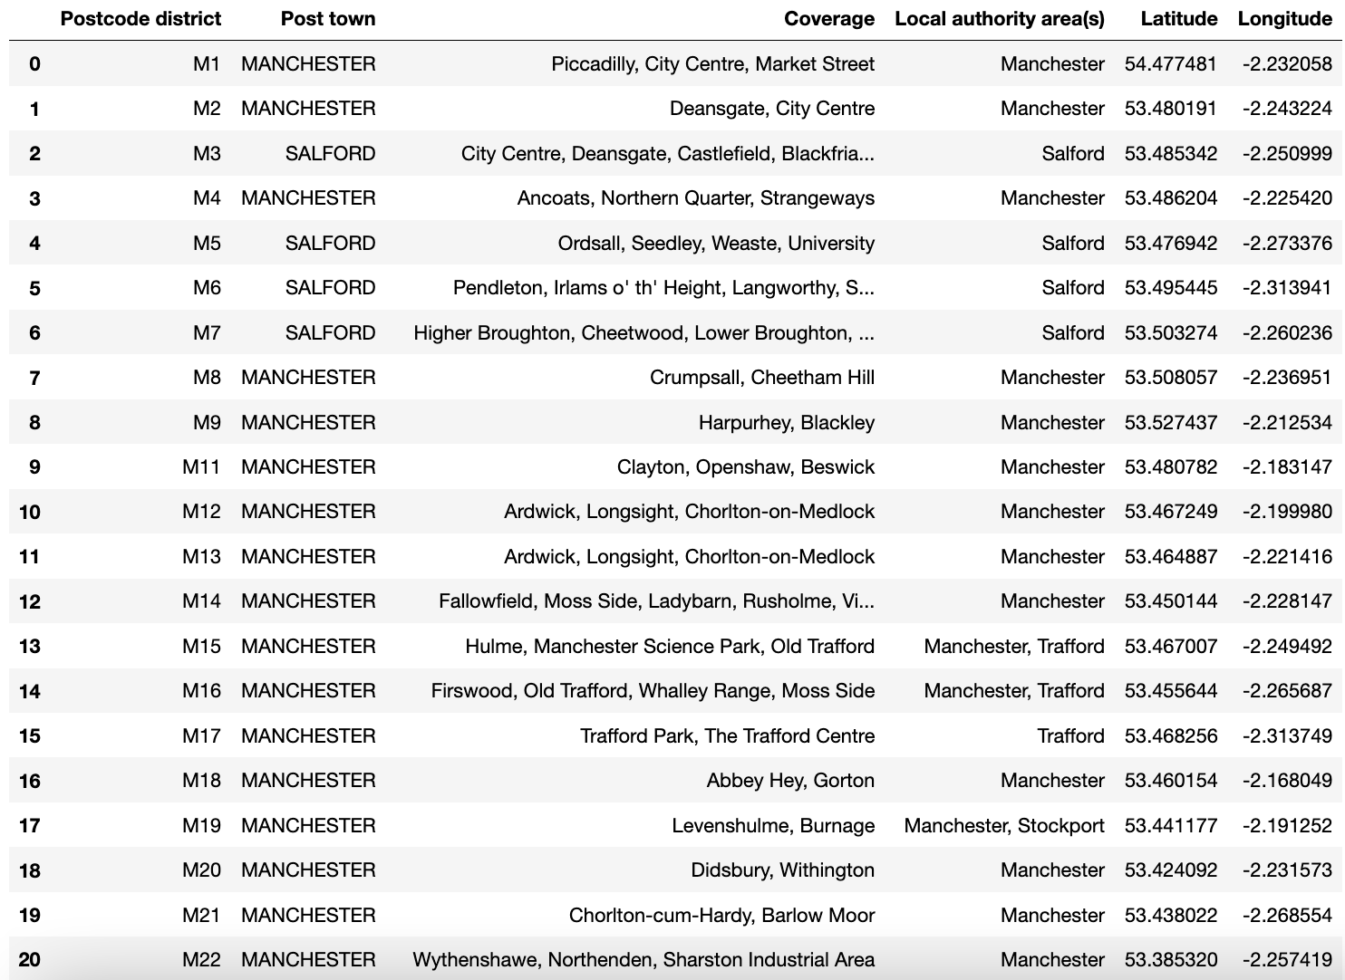
Results - Post Code Area Values .. Part 1

Slide 5
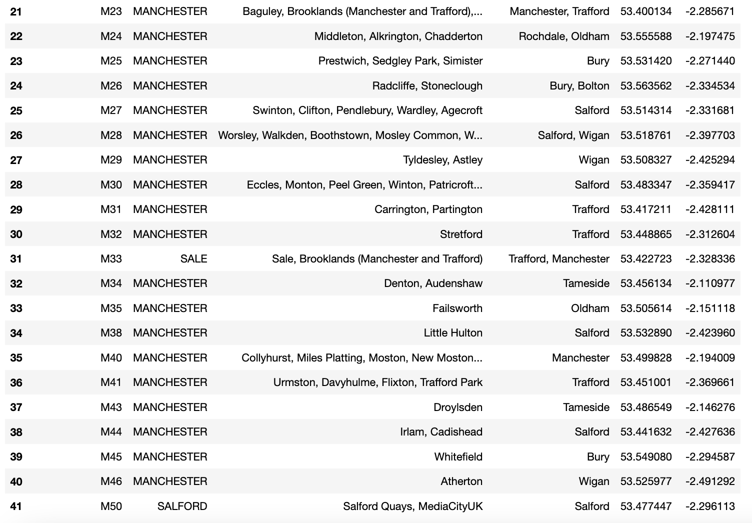
Results - Post Code Area Values .. Part 2

Slide 6
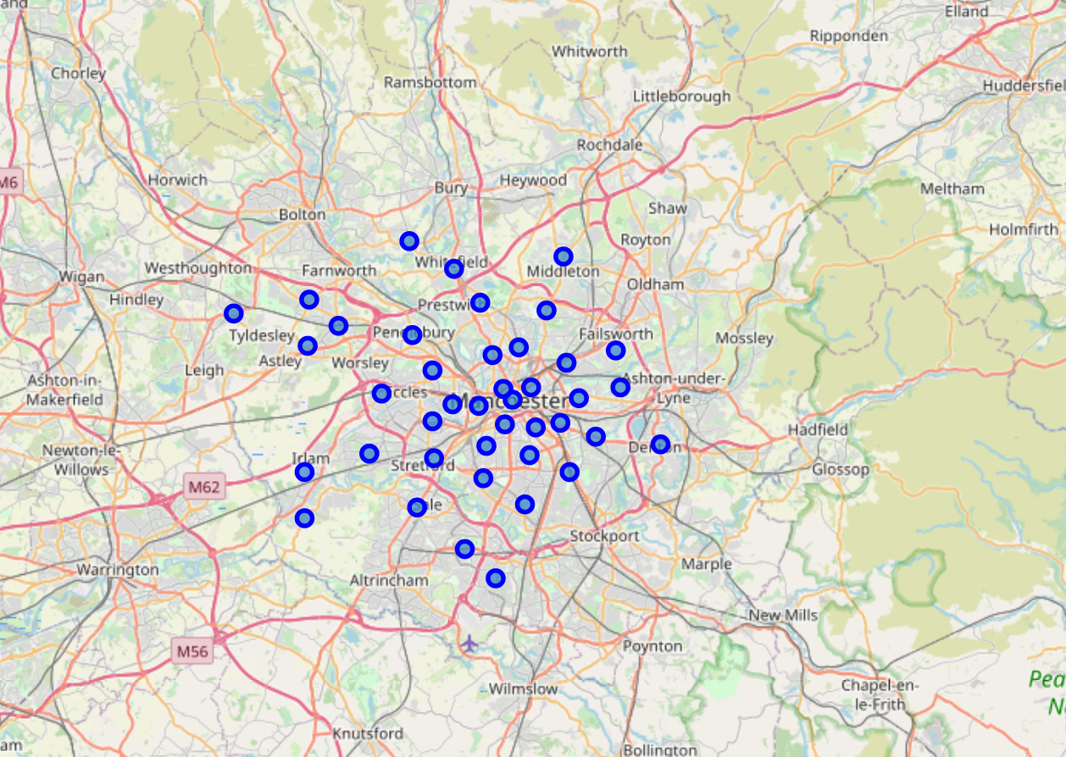
Results Post Code Area Coverage of Area - Map
Confirmation that Postal Code approach provides good geographical cover

Slide 7
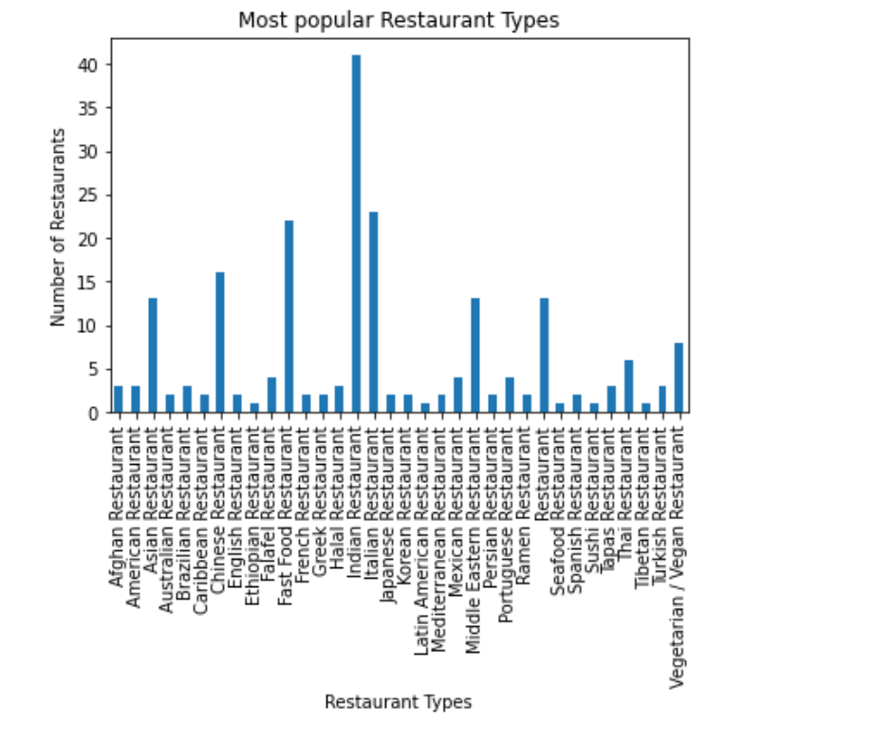
Results - Most common Restaurant types

Slide 8
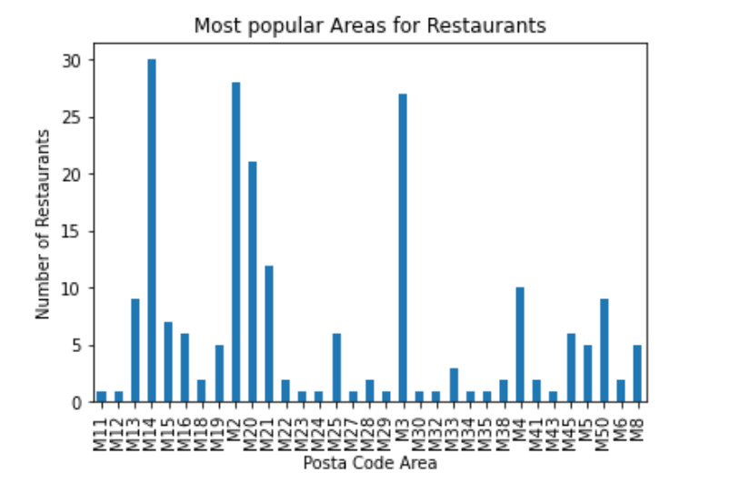
Results - Most popular culinary areas of Manchester

Slide 9
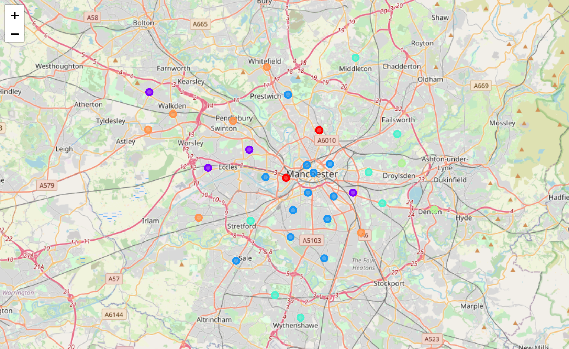
Results - K means Clustering by Restaurant Popularity
Indian / Vegan
Eclectic area - Indian / Italian / Asian / Middle Eastern
Chinese and Asian
Fast Food & Vegan
Fast Food / Mixed
Italian and Ethiopian

Slide 10
Observations….part 1
Postal code areas M2, M3 and M14 had the highest number of restaurant venues.
M4, M13, M20, M21 and M50 are in the second tier of popularity.
Indian, Italian and Fast Food restaurants are the most common types of restaurant overall in the Manchester area.
The second tier of popularity includes Asian, Chinese and Vegan restaurants.

Slide 11
Observations….part 2
K means clustering showed the following food type area clusters
Indian / Vegan
Eclectic area - Indian / Italian / Asian / Middle Eastern
Chinese and Asian
Fast Food & Vegan
Fast Food & Asian
Italian and Ethiopian
Note that the most popular areas M2, M3 and M14 are all in the “eclectic area” where there is most varied mix of restaurants. (see next page)

Slide 12
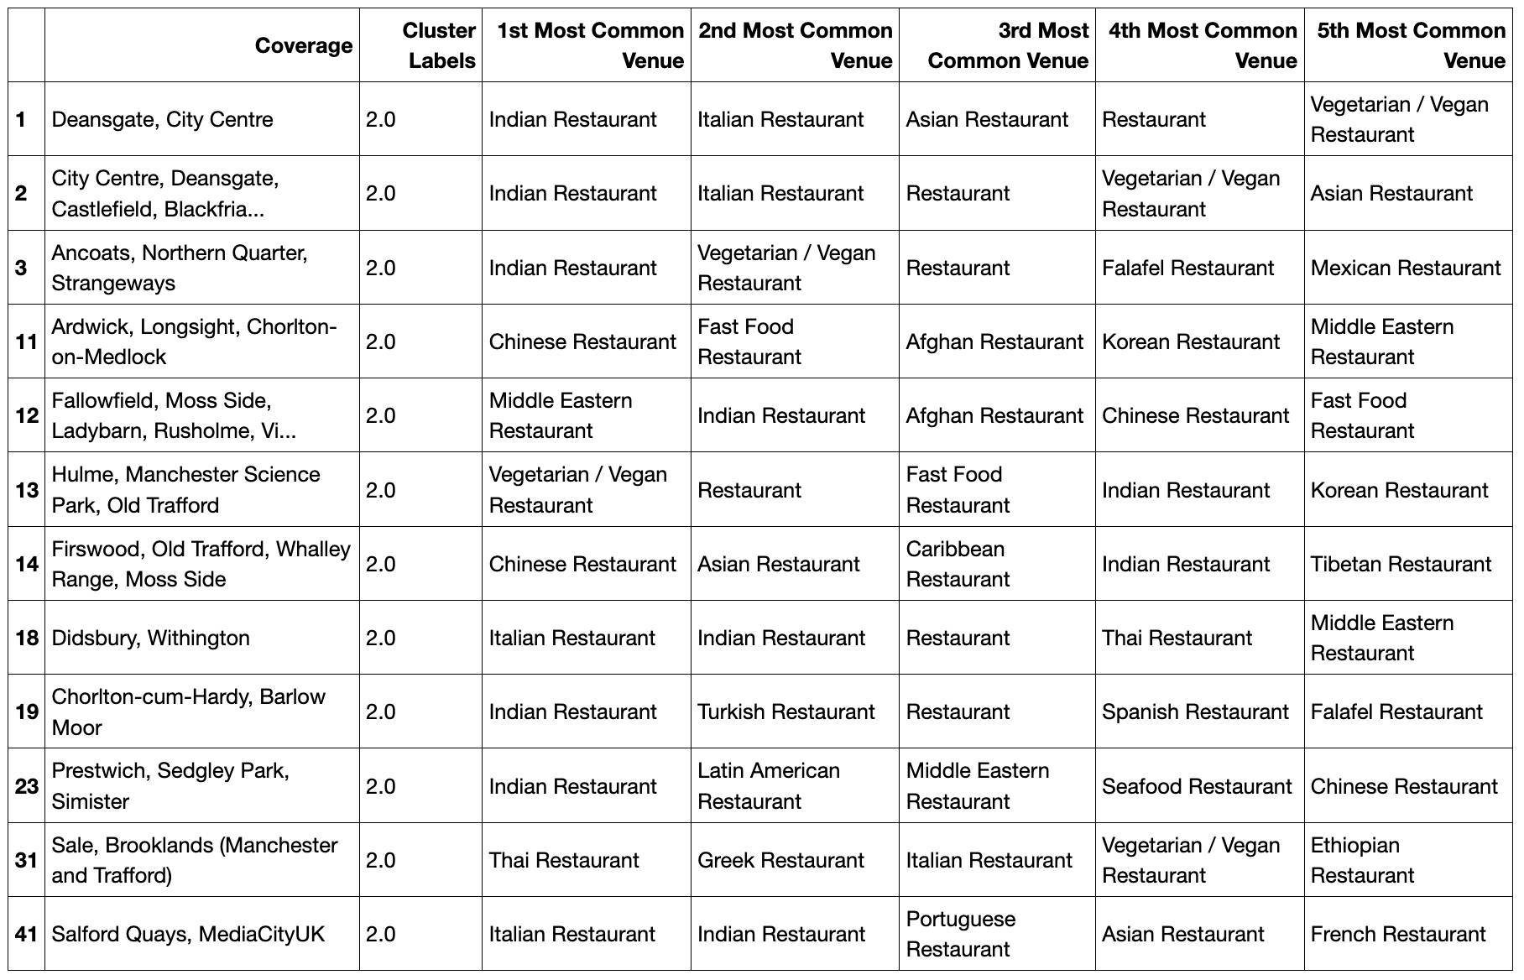
Popular areas are in “Eclectic” cluster
M2
M3
M14
Busiest areas are in cluster with good mix of restaurants. There is no saturation of any particular restaurant type in these areas

Slide 13
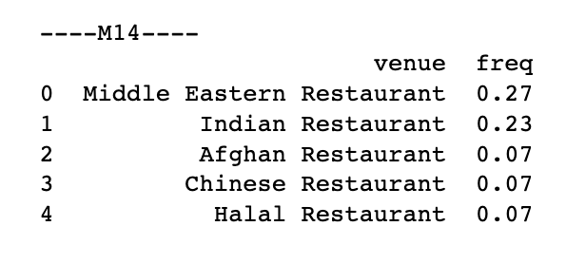
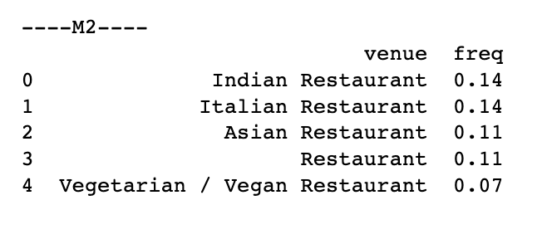
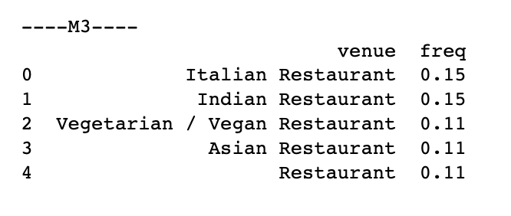
Observations….part 3
Detailed M2, M3 and M14 analysis
In the 3 most popular areas M2, M3 and M14 , Indian restaurants were not the most common only in M14 area.

Slide 14
Conclusion / Recommendation
The most popular restaurant type in Manchester is Indian and the three most popular areas for restaurants in Manchester are M2, M3 and M14.
Indian restaurants are currently the most common restaurant type in M2 and M3 areas already.
Final Recommendation: Open an Indian restaurant in the M14 area of Manchester.

